Slide 1
Tyrant VC
Vlad Loyko, Carson Wilk, Ben Celsi, Annie Gesellchen

Slide 2
Introduction
We are TyrantVC, an easy to use Version Control plugin for Maya

Slide 3

Maya Background
● Maya is a professional
animation software
● Maya scripters typically
unfamiliar with Git/VC
● However, they use Maya to
write automation scripts

Slide 4
Motivation
● Scripts can only be run within Maya
● Users frequently want to access previous working versions of their scripts
● Charcoal revamps Maya script editor, but has no Version Control
● Github Desktop requires switching in/out of Maya
● Maya scripters need an efficient workflow, and wouldn’t want a separate Git

Slide 5
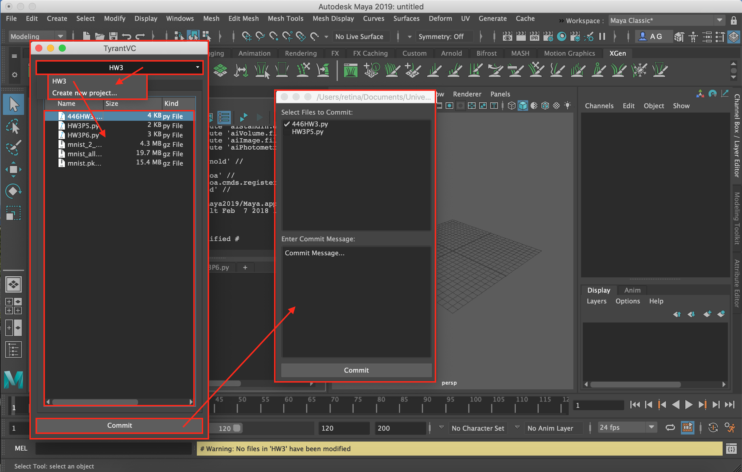
Our Solution: TyrantVC
Maya plugin integrated with the Script Editor
Allows users to see repository, commit files, and view history
Fits seamlessly into workflow

Slide 6
Demo!

Slide 7
Evaluation
● Some tests can check correctness of code
● But mostly, success is measured by how well customers can understand and use our plugin
● Ran user studies with actual customers
● Provided customers with a list of tasks and the user manual
● After the study, customers filled out a survey on usability

Slide 8
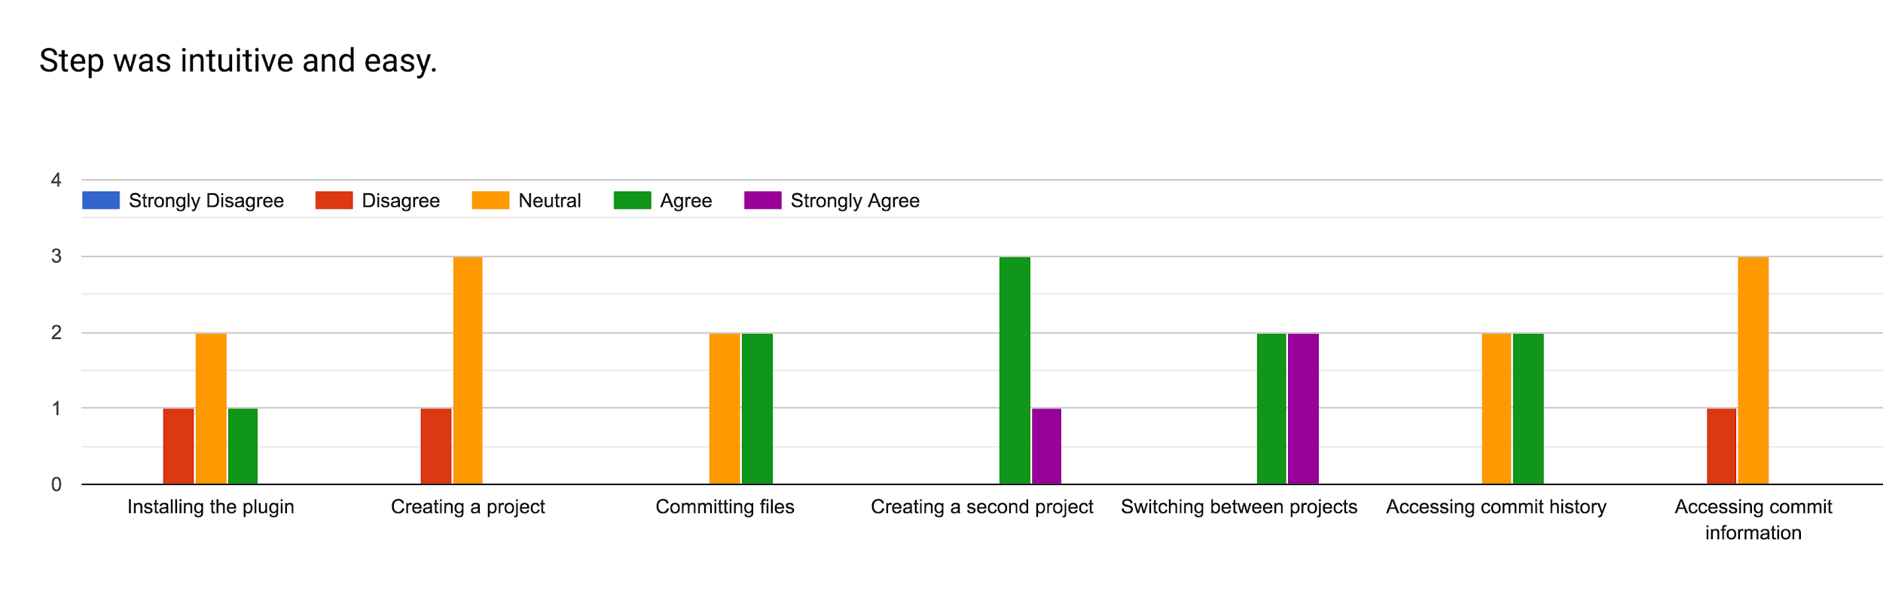
User Testing Results

Slide 9
Summarized Feedback
● Still a few difficulties in setup and getting started
● Once they had the plug-in working, people were mostly able to use the core functionality easily and efficiently
● Those who didn’t already know version control struggled to understand history

Slide 10
TyrantVC Moving Forward
● Work on making commit history more understandable to non-Git users
● Make UI changes for clarity improvements
● Deploy plugin to the scripters in the UW Animation Lab
● Run long-term studies to see how much the plugin is being used

Slide 11
Summary
● Maya scripters need version control, but don’t know Git
● TyrantVC works as a interface to Git through Maya
● User studies show people mostly understand how to use TyrantVC
● There are still improvements to be made, but Maya scripters can now use TyrantVC

